Slide 1
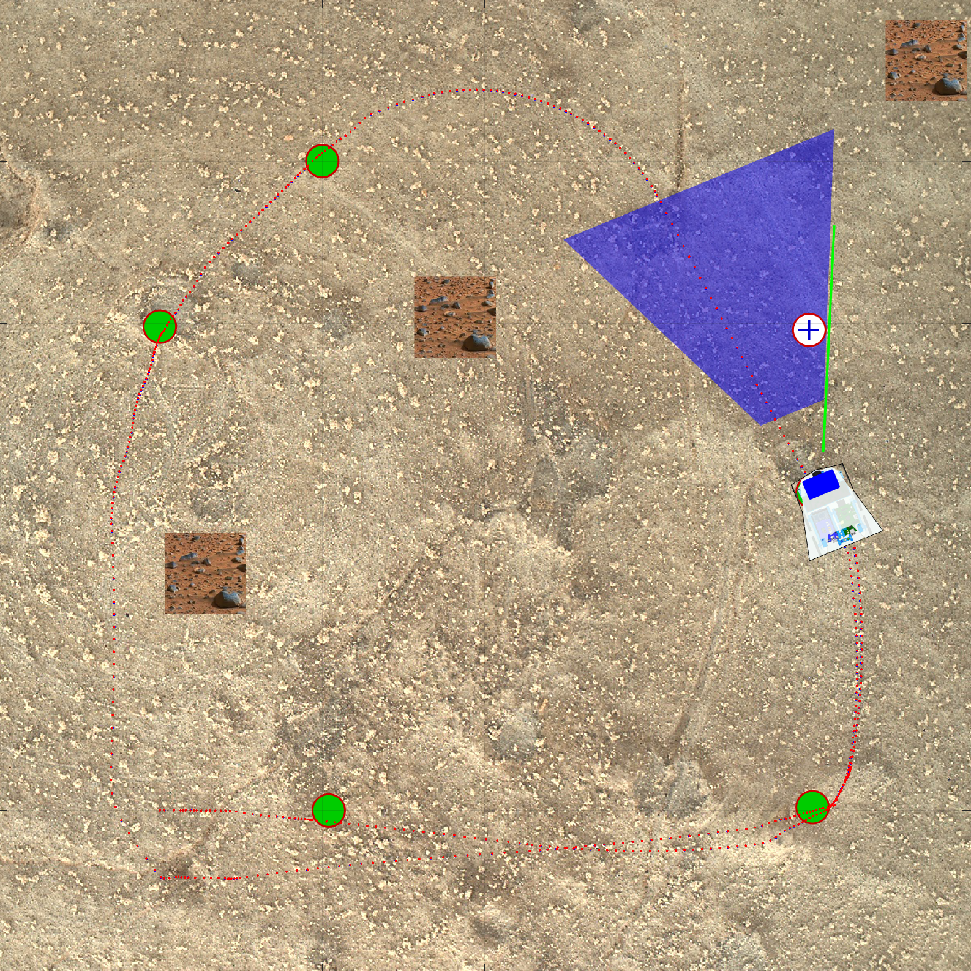
Mission on Mars Rover Competition
Current Progress:
3/23/16

Slide 2
Recap - Mission Goals
Must go to all six target locations
Avoid all obstacles
Achieve the above in the shortest time possible

Slide 3
Implemented Plans
Rover will search for targets in a certain path
This path will involve an outer and inner loop
Rover will use walls to navigate the outer loop
Rover will then transition to inner loop and perform scans to find remaining targets

Slide 4
Shows the general path the rover will take around the arena
Rover will search for targets in outer loop while avoiding obstacles
Transition to inner loop will be based off how many walls the rover detects in the outer loop
Then do an inner loop, scanning for targets
Obstacle avoidance will be different in inner loop

Slide 5
Current Algorithms
Rover responds differently to each obstacle
Can detect walls and avoid
Walls are used as ways to traverse arena
Rover can go around objects directly in front of it
This is being revised
The response to obstacles will change for each of the two loops
Ex: rover will not go around objects in inner loop due to small area. It will instead turn right or left and continue

Slide 6
Problems and Solutions
Rover sometimes overcompensates when avoiding a wall, causing it to be off course
Will set mode to ”DISTANCE” and make 90 degree turn. Must give rover time to complete turn.
If the rover detects a target near the edge of its field of view, moving and turning towards it sometimes causes it to loose it and abort
Will make rover turn a certain amount depending on how close the target is from the edge of the field of view
Rover must be able to determine which targets are worth deviating from its path.
Targets close to the center will be ignored, since they will be detected later. A target will need to be within a certain distance from the rover before it tries to go to it.

Slide 7
Problems and Solutions Continued…
Rover can not rely on walls to do navigate inner loop
Small movements will be made and rotational scans will be conducted to find targets. The center area is small enough to allow this.
Rover must be able to better avoid objects directly in front of it
Based off the distance measured from when the rover first detects the object, it can use trigonometry to determine the best avoidance path around the object. Rover can us wall to go back to path. This will be different for the inner loop. Instead, rover will make a 90 degree turn and not try to go around object.

Slide 8
Mapping
Save blocks of distance into memory
Check unchecked blocks if all targets not reached

